Slide 1




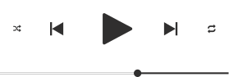

SPOTIFY
Spotify
Home
About
Content
Others
Presentation
Guillermo David
James Latanna
Matthias Mangold

Slide 2


Smash Mouth - All Stars
CONTENTS:
HOW DOES THE DURATION OF A TRACK AFFECT ITS POPULARITY?
DOES FOLLOWERS AFFECT ARTIST'S POPULARITY IN THE TOP 100?
DOES THE DANCEABILITY AFFECTS THE POPULARITY OF A SONG?

Slide 3

Darude - Sandstorm
RESEARCH QUESTION 1 : HOW DOES THE DURATION OF A TRACK AFFECT ITS POPULARITY?
H₀: THERE IS NO SIGNIFICANT DIFFERENCE IN POPULARITY BETWEEN TRACKS OF DIFFERENT LENGTHS (SHORT, MODERATE, AND LONG).
H₁: TRACKS WITH MODERATE LENGTH (3 TO 4 MINUTES) ARE MORE POPULAR THAN SHORTER OR LONGER TRACKS.

Slide 4
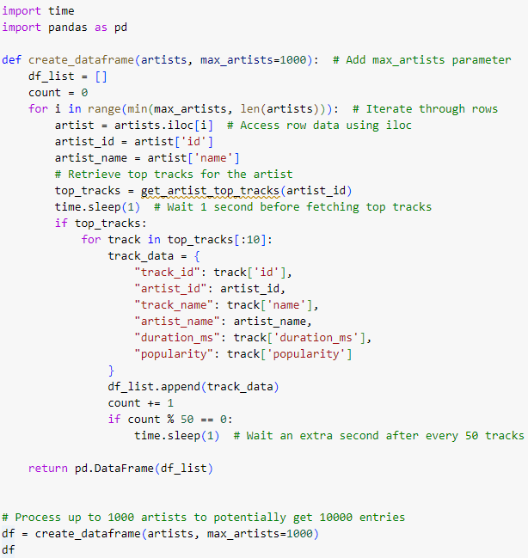
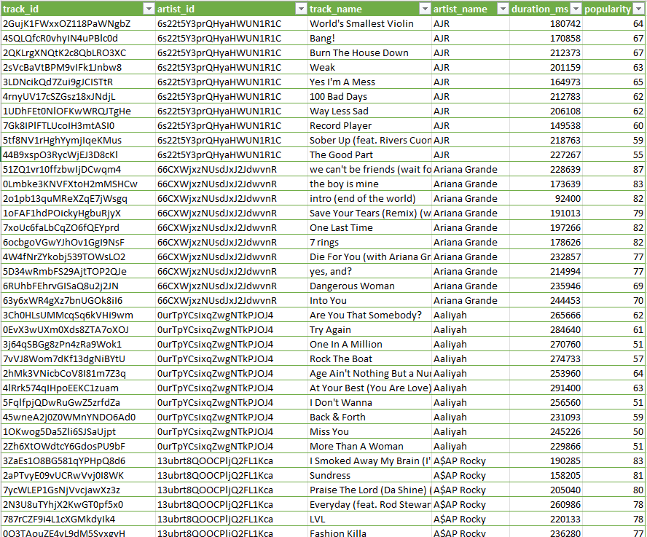
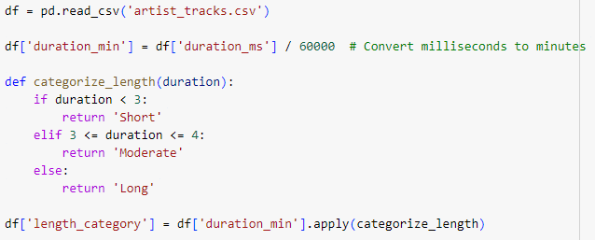

RESEARCH QUESTION: HOW DOES THE DURATION OF A TRACK AFFECT ITS POPULARITY?
1. COLLECT DATA FROM SPOTIFY WEB API
2. PREPROCESS DATA

Slide 5
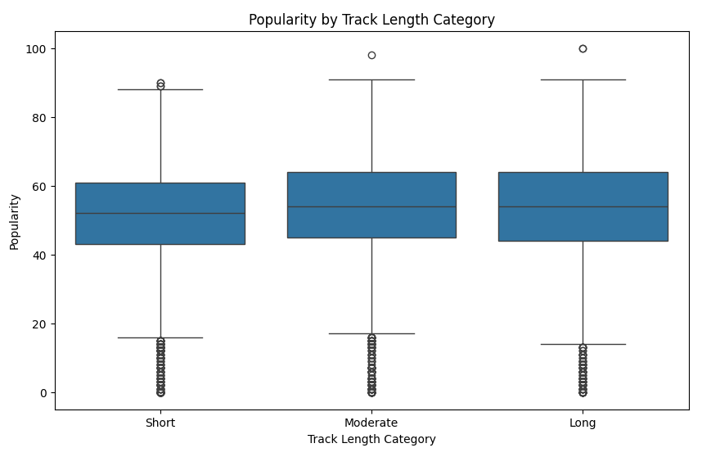
RESEARCH QUESTION: HOW DOES THE DURATION OF A TRACK AFFECT ITS POPULARITY?
3. EXPLORATORY DATA ANALYSIS
The median popularity score for all track length categories (short, moderate, and long) is quite similar, around 55 to 60.
All three categories contain a few outliers above the 80th percentile, indicating that some tracks achieve a high popularity score, regardless of length.
The lower and upper whiskers show that the popularity distribution spans a wide range in each category, with minimum values close to 0 and maximum values near 100. The range of popularity is similar for all track lengths.

Slide 6
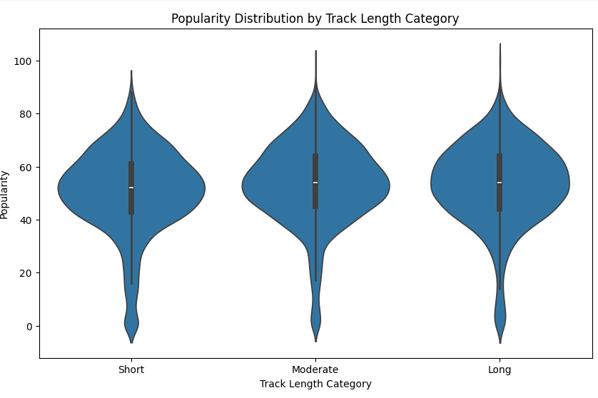
RESEARCH QUESTION: HOW DOES THE DURATION OF A TRACK AFFECT ITS POPULARITY?
3. EXPLORATORY DATA ANALYSIS
All three track length categories have a similar shape and a concentration of tracks with popularity scores around 45 to 55.
The median popularity is approximately the same for all categories, slightly above 50, and there are no significant visible differences in terms of central tendency between short, moderate, and long tracks.

Slide 7
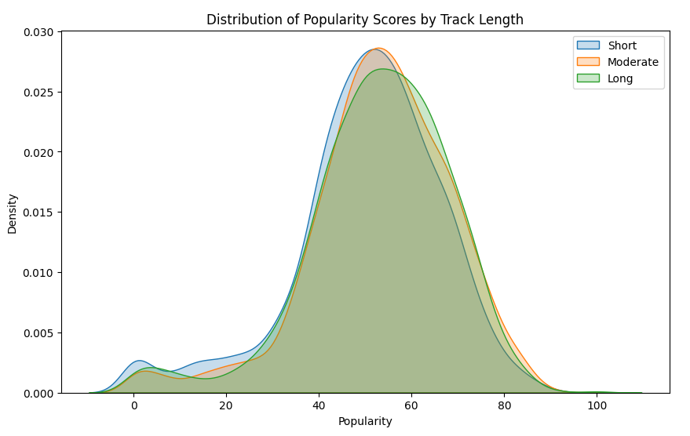
RESEARCH QUESTION: HOW DOES THE DURATION OF A TRACK AFFECT ITS POPULARITY?
3. EXPLORATORY DATA ANALYSIS
The peaks for all categories occur in the 50-60 popularity range, with moderate-length tracks showing a very slight shift toward the higher popularity range compared to the short and long tracks.
The curves largely overlap, indicating minimal differences between the distributions.

Slide 8
RESEARCH QUESTION: HOW DOES THE DURATION OF A TRACK AFFECT ITS POPULARITY?
3. EXPLORATORY DATA ANALYSIS
Conclusion of EDA:
Based on the box, violin, and density plots, the data does not provide strong evidence to support the alternative hypothesis (H₁) that tracks of moderate length (3 to 4 minutes) are more popular than shorter or longer tracks.
The null hypothesis (H₀), which states that there is no significant difference in popularity between tracks of different lengths, appears to hold.

Slide 9
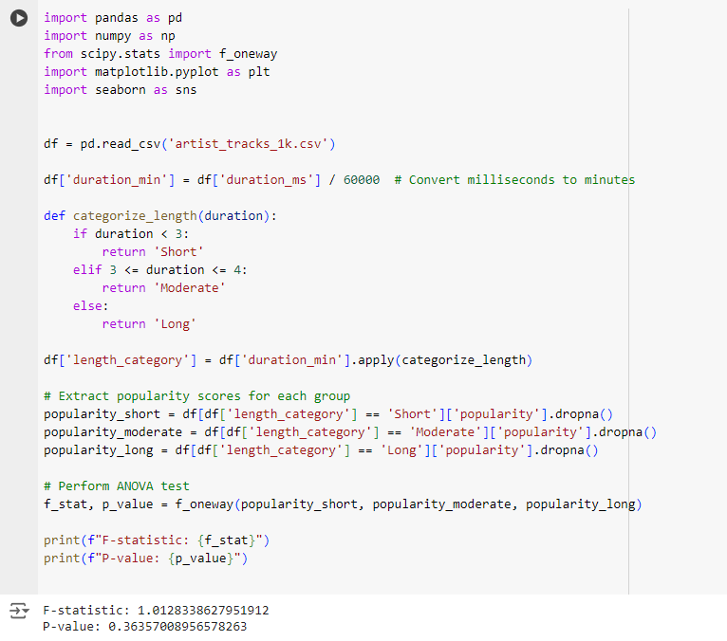
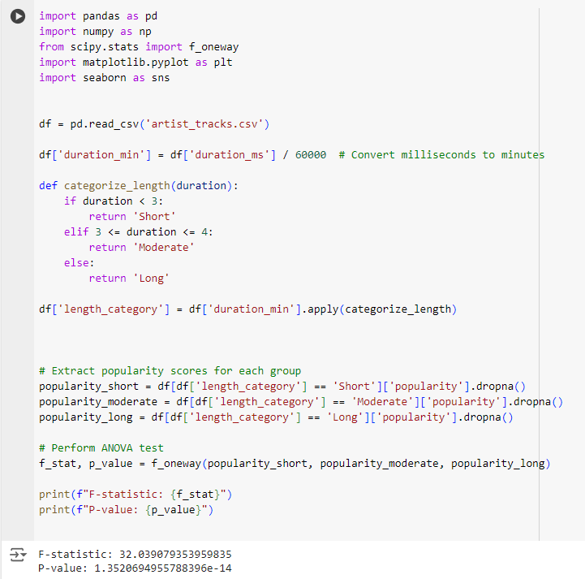

RESEARCH QUESTION: HOW DOES THE DURATION OF A TRACK AFFECT ITS POPULARITY?
4. ANOVA TEST
Hypothesis:
H₀: There is no significant difference in popularity between tracks of different lengths (short, moderate, and long).
H₁: Tracks with moderate length (3 to 4 minutes) are more popular than shorter or longer tracks.
Now, with smaller dataset:
Before, with large dataset:
Fail to Reject H₀​:
We would reject the null hypothesis since the p-value is much smaller than 0.05.
Using a smaller sample size, the p-value is now greater than 0.05. we fail to reject the null hypothesis H₀​.
This means there's no statistically significant difference in popularity between tracks of different lengths based on this sample.
Possible Reason:
Large Sample Size: ANOVA is sensitive to sample size, and large samples can produce low p-values even when group means are very close.

Slide 10
Thynk Unlimited
RQ 2 : DOES FOLLOWERS AFFECT ARTIST'S POPULARITY IN THE TOP 100?
H₀:
The number of followers does not significantly affect the artist's popularity
H₁:
The number of followers has a significant impact on the artist's popularity

Slide 11
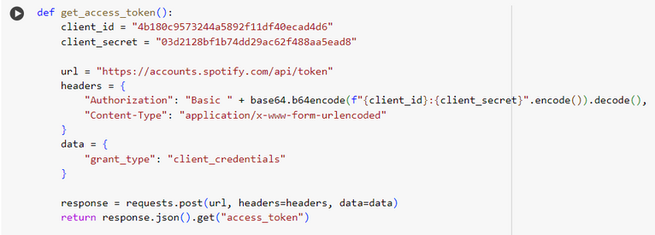
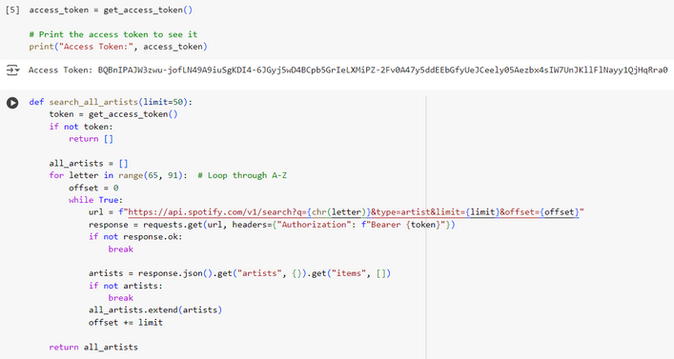
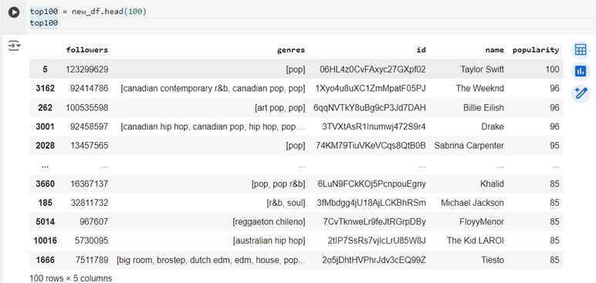
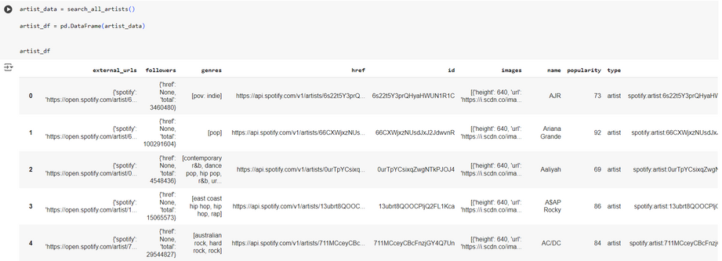
Continuum
The function sends a POST request to Spotify's server to obtain the access token from the JSON response.
The client ID and secret are combined and encoded in Base64 to ensure security before being sent to Spotify. This encoding protects the sensitive information.
A GET request is then sent to the Spotify API, with the authorization header containing the access token.
The loop continues to request more data until there are no more results for a given letter.
Filter it to get the top 100 popular artists

Slide 12
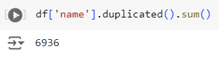
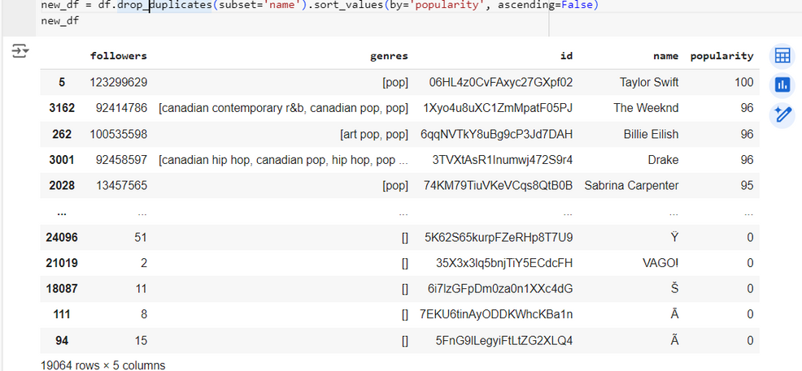
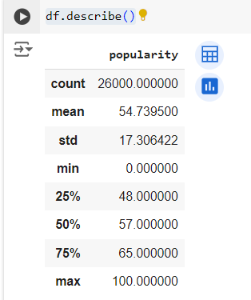
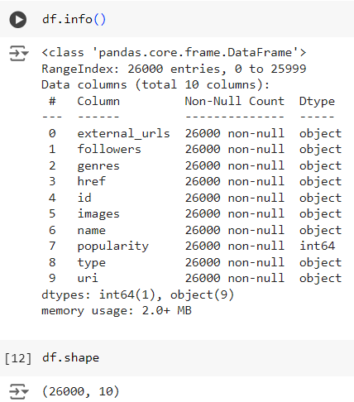
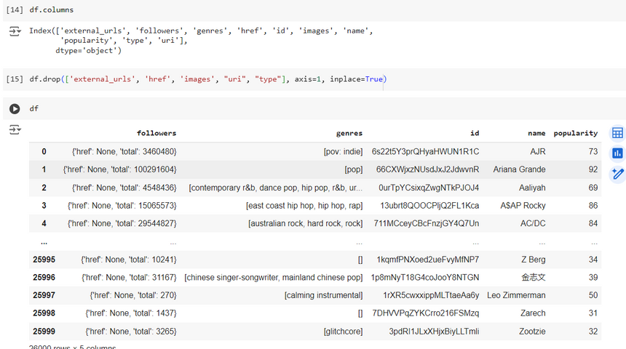
check if the df has any duplicated items
drop any duplicated items and sort the df by popularity
8
Drop columns that are unrelated to objectives

Slide 13
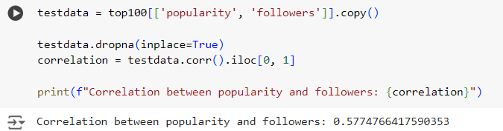
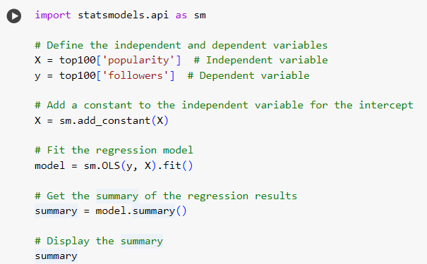
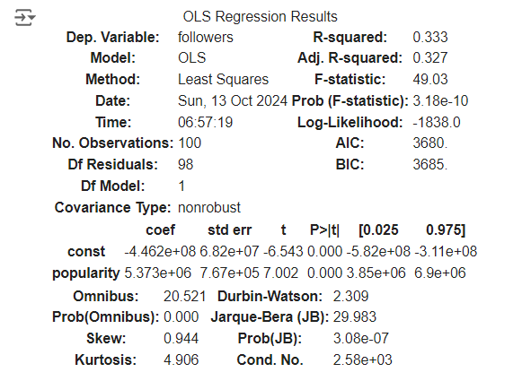
Thynk Unlimited
RQ 2 : DOES FOLLOWERS AFFECT ARTIST'S POPULARITY IN THE TOP 1000?
Check the coorelation between popularity and followers
this indicates a moderate positive relationship between followers and popularity.
So when the followers increase the popularity will also increase
2. Use regression model to further find out information about it

Slide 14
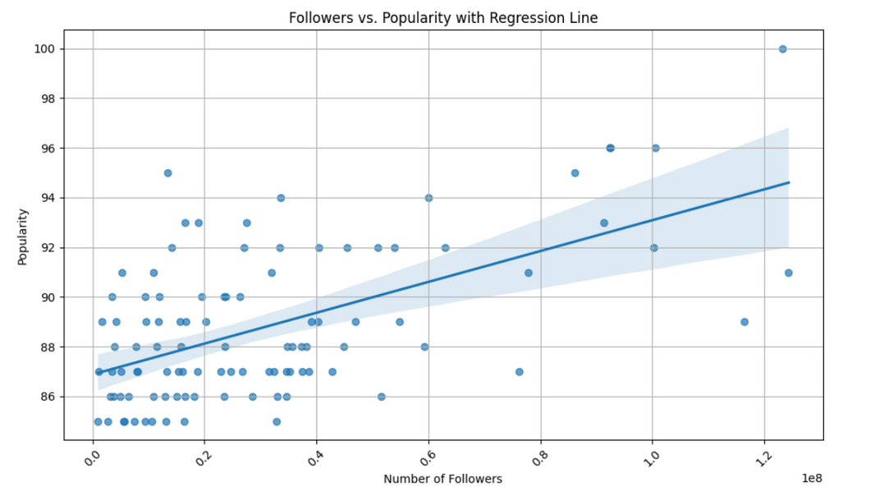
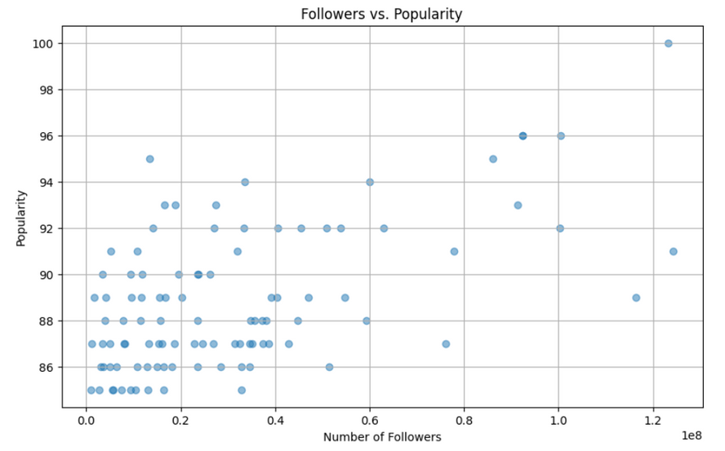
Thynk Unlimited
Home
About
Content
Others
RQ : DOES FOLLOWERS AFFECT ARTIST'S POPULARITY IN THE TOP 100?
3. Visualize the data
To better see the results, use a graph to visualize i
To better see the results, we can add regression line
to see that it is in fact inclining

Slide 15
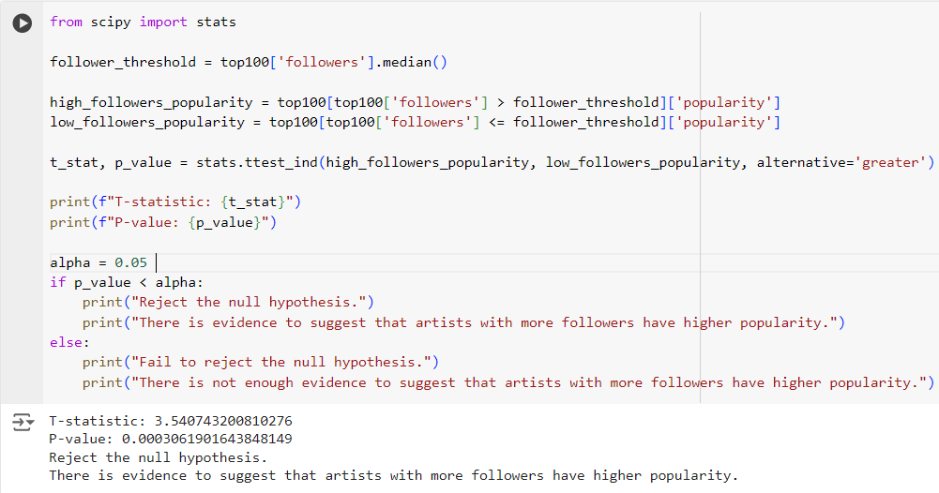
Thynk Unlimited
Home
About
Content
Others
RQ : DOES FOLLOWERS AFFECT ARTIST'S POPULARITY IN THE TOP 1000?
4. null hypothesis

Slide 16




RQ 3 : DOES THE DANCEABILITY AFFECTS THE POPULARITY OF A SONG?
H0
H1
Danceability does not have a significant effect on the popularity of a song.
Danceability has a significant effect on the popularity of a song.

Slide 17
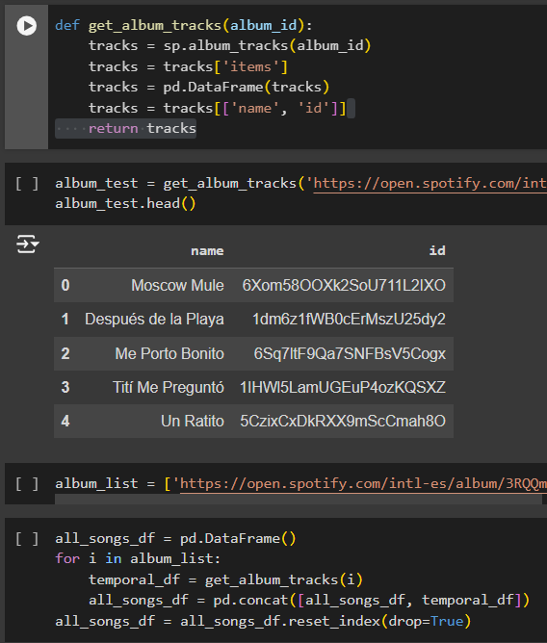
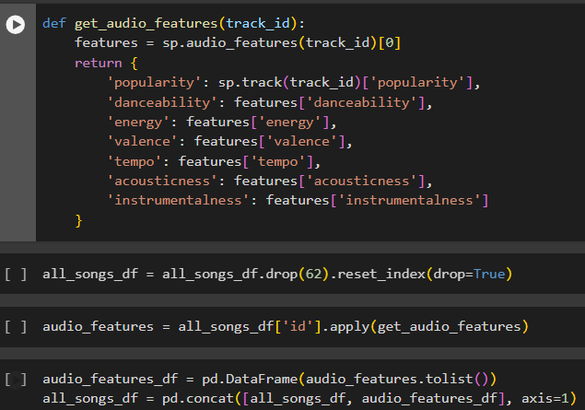

GETTING DATA

Slide 18
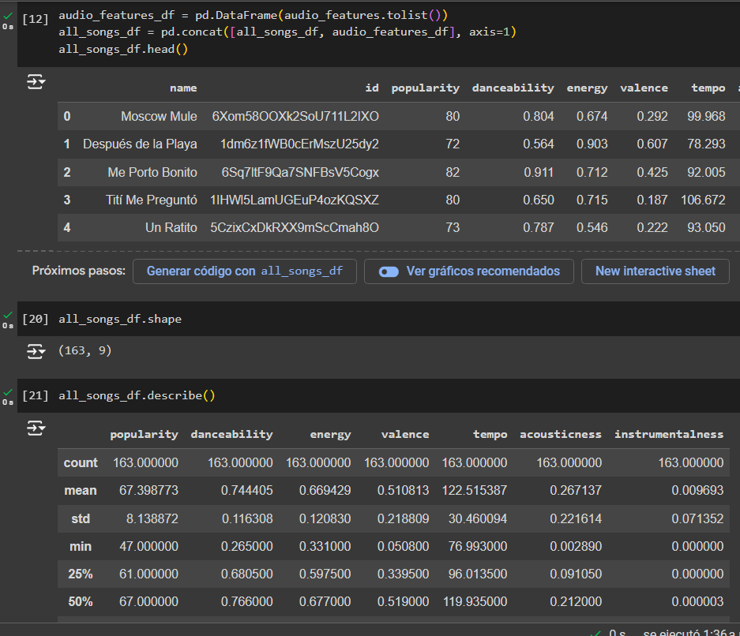
DATA

Slide 19
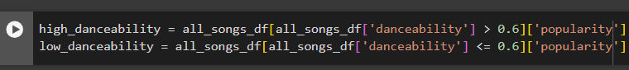
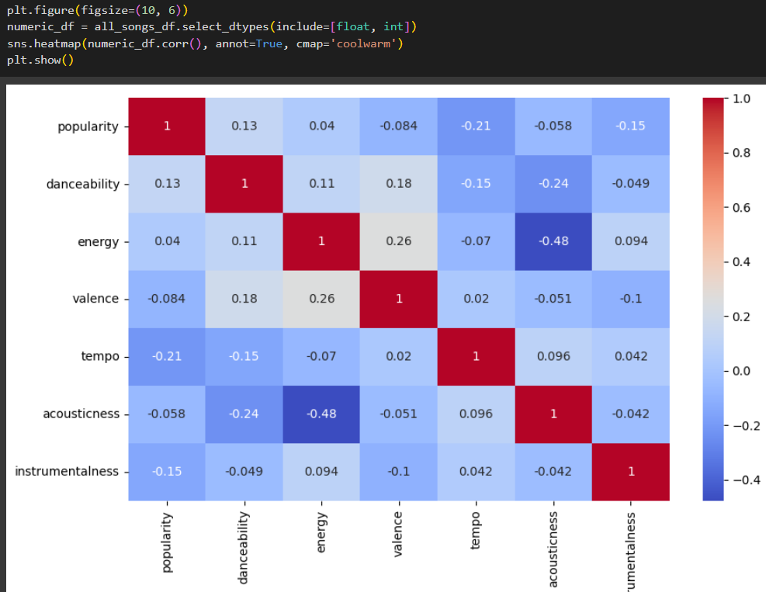
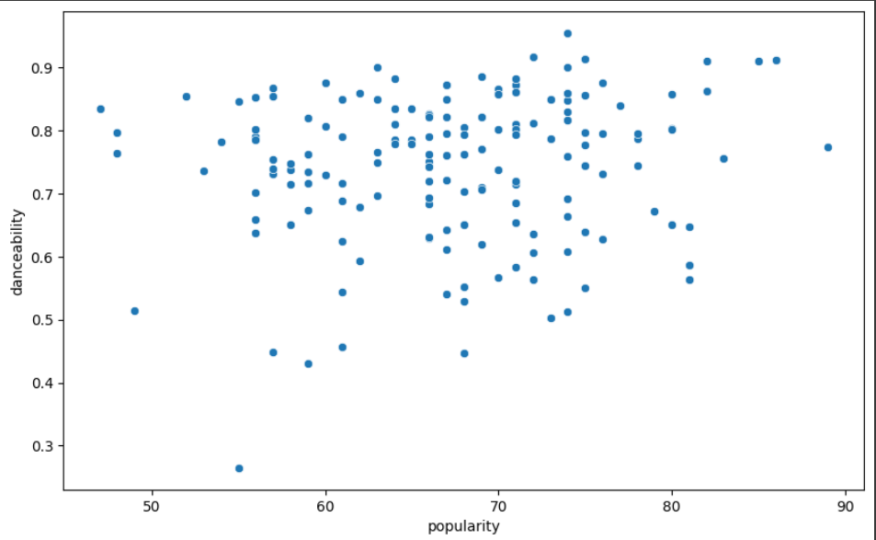

Slide 20
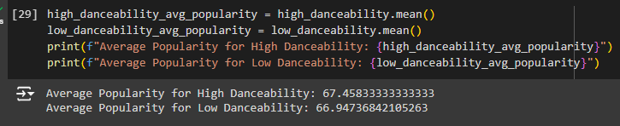
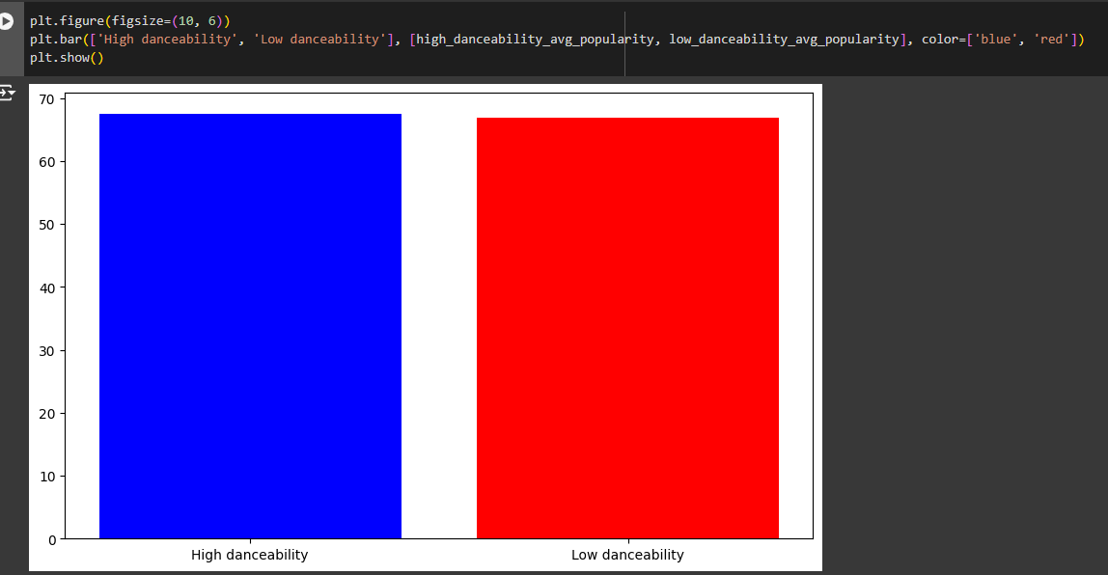
COMPARING THE AVERAGE

Slide 21
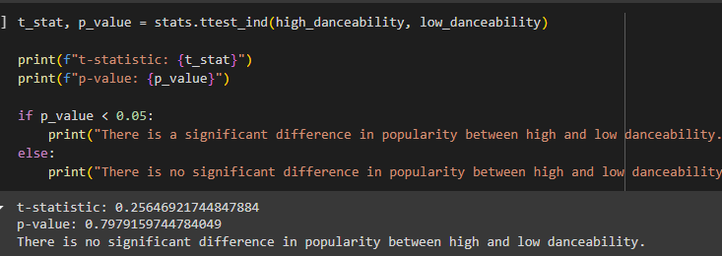
RESULT
Fail to reject the H0

Slide 22

Where the list
Home
About
Content
Others
Conclusion
in our data there are a lot of factors that affects an artists or a track popularity
The first case was there is no statistically significant difference in popularity between tracks of different lengths based on this sample.
second case is that there is evidence to support the claim that artists in the top 100, ones who has more followers also have higher popularity
third case is was no statistically significant difference between the songs with high danceability and low danceability. We need more samples

Slide 23
Where the list
Home
About
Content
Others
References:
Welcome to Spotipy! — spotipy 2.0 documentation. (n.d.). Spotipy.readthedocs.io. https://spotipy.readthedocs.io/en/2.24.0/
Spotify. (n.d.). Web API | Spotify for Developers. Developer.spotify.com. https://developer.spotify.com/documentation/web-api
‌

